Slide 1


Capstone Project
by Elias Joy

Slide 2
Problem Overview
Comprehensive Data Pipeline with Azure Data Factory, Databricks and Dashboard for Insightful analysis on Uber/Lyft Cab Prices and Weather Impact on Surcharge
The problem statement of this project is to design and implement a scalable data pipeline using Azure Data Factory and Databricks to ingest, transform, and analyze Uber/Lyft cab pricing data and weather conditions.
The aim is to develop a reliable data model and visualization layer that provide actionable insights into the impact of weather on cab surcharges.
This will assist stakeholders in identifying patterns, forecasting demand, and optimizing pricing strategies under varying conditions, thereby enhancing the overall decision-making process for pricing and operational efficiency.

Slide 3

Input Data Sources
1
Weather Data
2
Uber Data
Pulled from a CSV file hosted in a Git repository. Containing detailed weather conditions for Boston during the period of cab data collection.
Stored in Azure Blob Storage as CSV file, containing trip details and pricing information of Uber Cab Rides.
3
Lyft Cab Data
Sourced from an Azure SQL Database, containing trip details and pricing information of Lyft Cab Rides

Slide 4

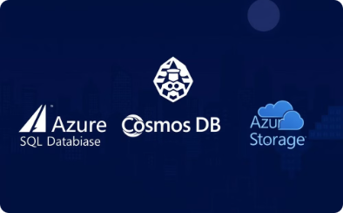


Tech Stacks Used
Data Ingestion
Data Storage
Data Processing & Transformation
Data Visualization
Azure Data Factory orchestrates the data ingestion process, pulling data from various sources.
Data is stored in various locations, including Azure Blob Storage, Azure SQL Database, and Cosmos DB.
Databricks dashboard presents visualization of key insights from the processed data
Azure Databricks performs data cleansing, transformation, and feature engineering using PySpark and Spark-SQL.

Slide 5




Solution Flow Diagram
Data Ingestion
Gather data from various sources like Git Repository( using Copy Data Tool) , Azure SQL Database, and Azure Blob Storage into the ADF
Storage
Merged Uber and Lyft datasets using a union operation in Data Flow due to their similar schema.
Stored merged outputs in Cosmos DB containers named Cab_Rides and Weather.
Data Cleaning and Transformation
Pulled data from Cosmos NoSQL into Databricks.
Cleaned null values and duplicates and Merged Cab data and Weather data.
Added a new column price_per_mile to standardize price analysis.
Converted time_stamp to a readable date format and added extra columns like date, hour, weekday.
Temporarily stored the final data in Databricks volume for further visualization.
Visualization
Visualized data to analyze trends, patterns, and correlations based on data-driven insights.

Slide 6
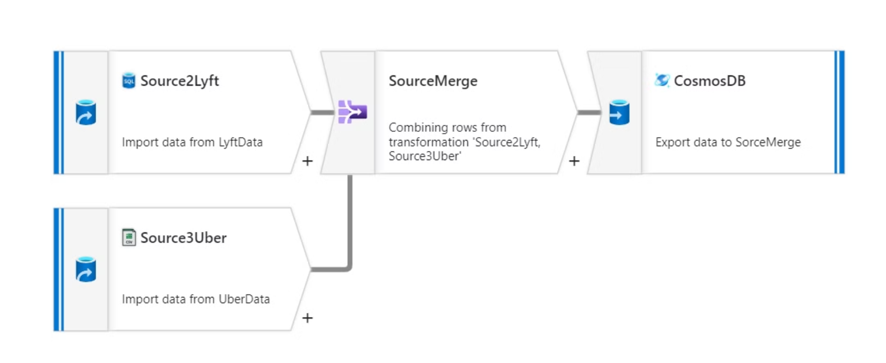
Data Flow : Merge Similar Sources

Slide 7
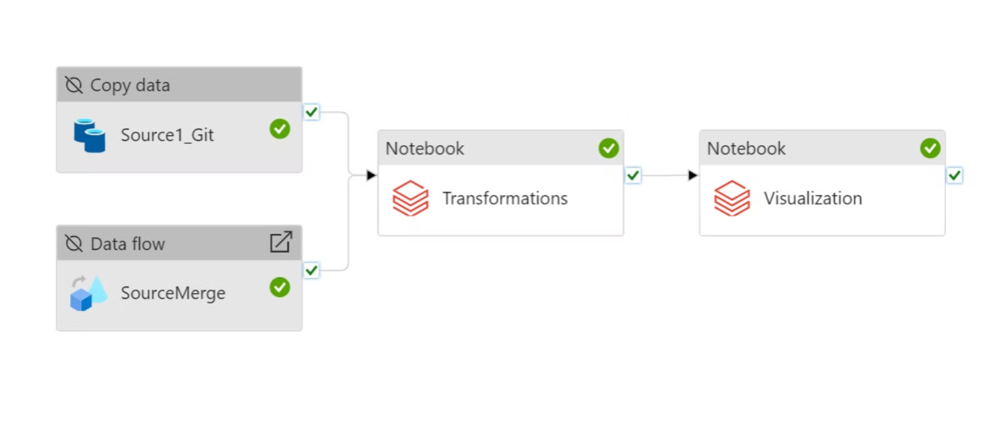
ADF Pipeline

Slide 8
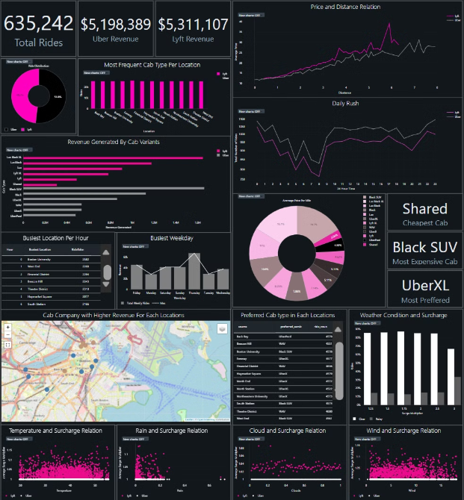
Dashboard
https://adb-3249565684546148.8.azuredatabricks.net/?o=3249565684546148#notebook/566598230449711

Slide 9
Solution Benefits
Business Impact
Data Insights
Enhanced Business Insights
Enables ride-sharing companies to understand how weather affects demand, optimize pricing models, and better serve customers.
Clear correlations can be derived between weather conditions (e.g., rain, snow) and surcharges, helping to predict peak demand periods.
Gain valuable insights into demand patterns, identify ride trends, and optimize resource allocation.

Slide 10
Key Insights:
Customer Preference: Uber was the most preferred service, despite Lyft generating higher revenue.
Revenue Analysis: Lyft’s revenue advantage was due to its surge multiplier, while Uber maintained a constant surge multiplier of 1.
Surge Multiplier Insights: The surge multiplier for Lyft was not influenced by weather conditions. Instead, it was determined by specific Lyft variants operating in particular locations.
Day-wise Trends: Thursday emerged as the busiest weekday for both services.
Service Comparisons:
Most Popular Service: UberXL had the highest usage.
Cheapest Option: Shared Lyft was the least expensive.
Most Expensive Option: Black SUV was the most premium offering.

Slide 11
Challenges Faced
Data Accuracy
Integrating data from multiple disparate sources into a single unified pipeline
Handling merge of two different datasets
Handling and cleaning null values and duplicates in merged datasets.
Data transformations
Data formatting and type conversion issues during transformation (e.g., time_stamp column) due to multiple format mismatches
System Implementation and Maintenance
Implement and maintain the system effectively to ensure seamless operation.
Data inconsistency
There existed many data that were inconsistent throughout the dataset, which were cleaned out before analysis.

